Slide 1
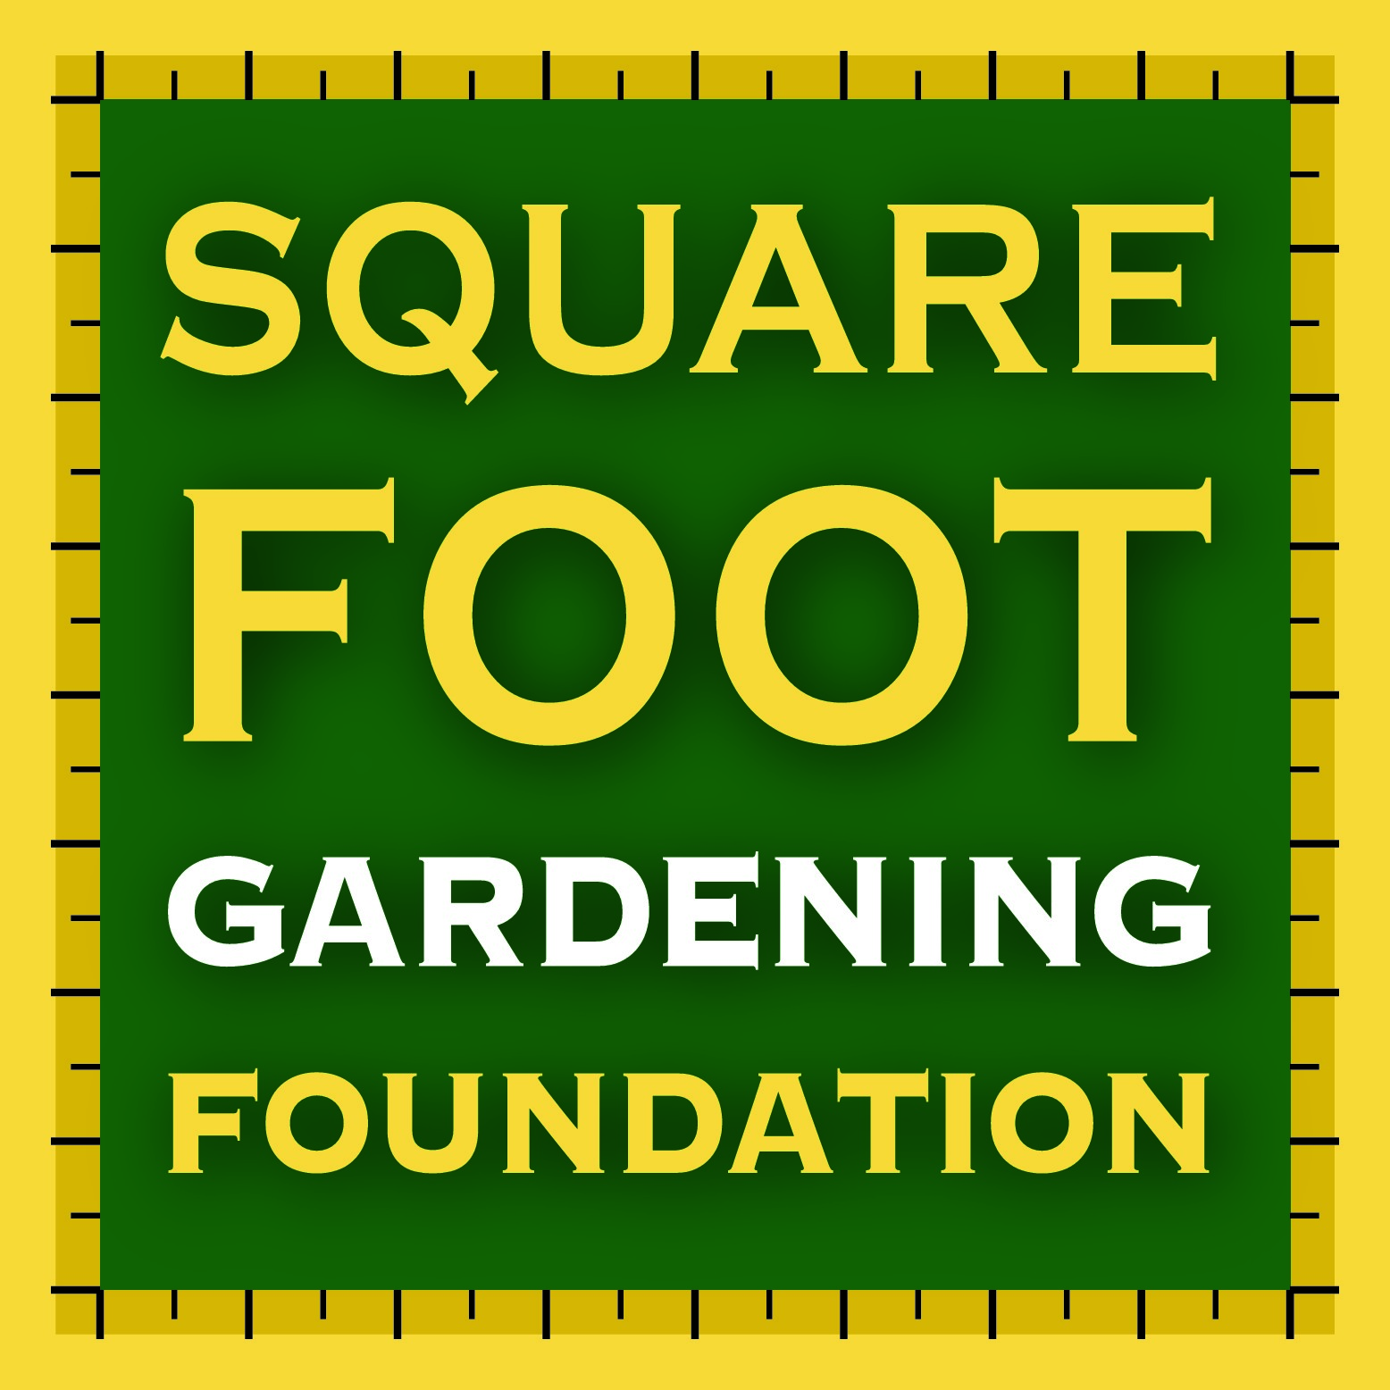
An Introduction to the Square Foot Gardening Method
A PowerPoint for Group Leaders to present to Pod Members
This information was adapted from the Square Foot Gardening Foundations materials created for the Gardening Webinar (available on PPC’s YouTube channel)

Slide 2
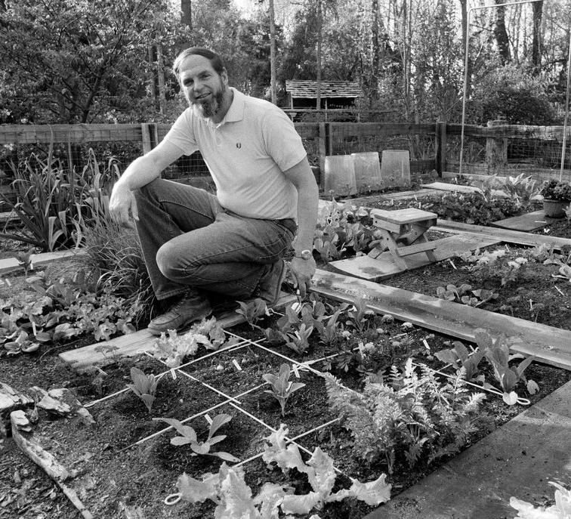
The Original Square Foot Garden (SFG)
Mel Bartholomew created the SFG method to:
Make gardening fun
Reduce the hard work
Be more efficient with time and resources

Slide 3
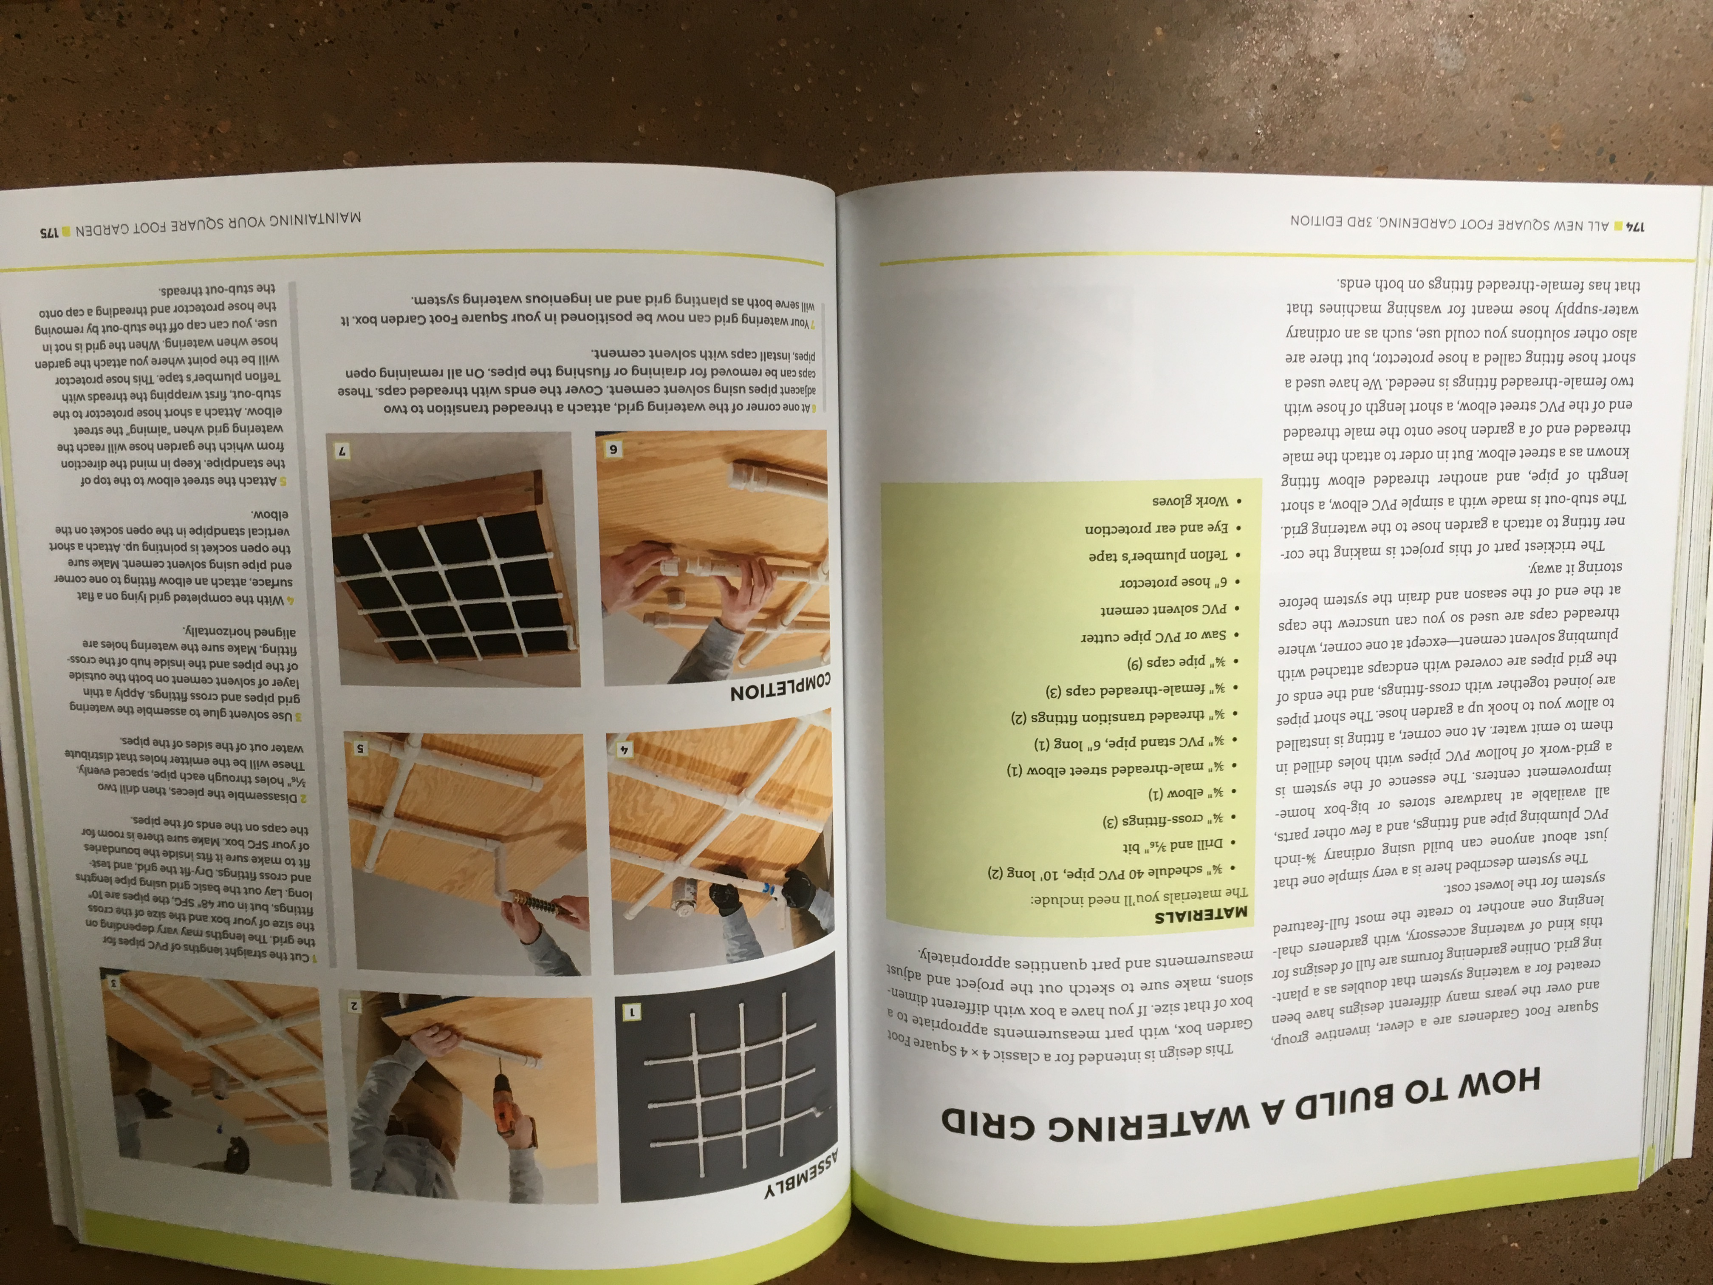
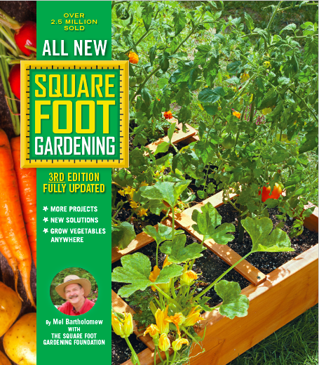
All New Book!
For more information and a full guide to SFG’ing we recommend using the All New Square Foot Gardening 3rd Edition book
Buy on Amazon for a communal Pod resource
Rent from your local library

Slide 4
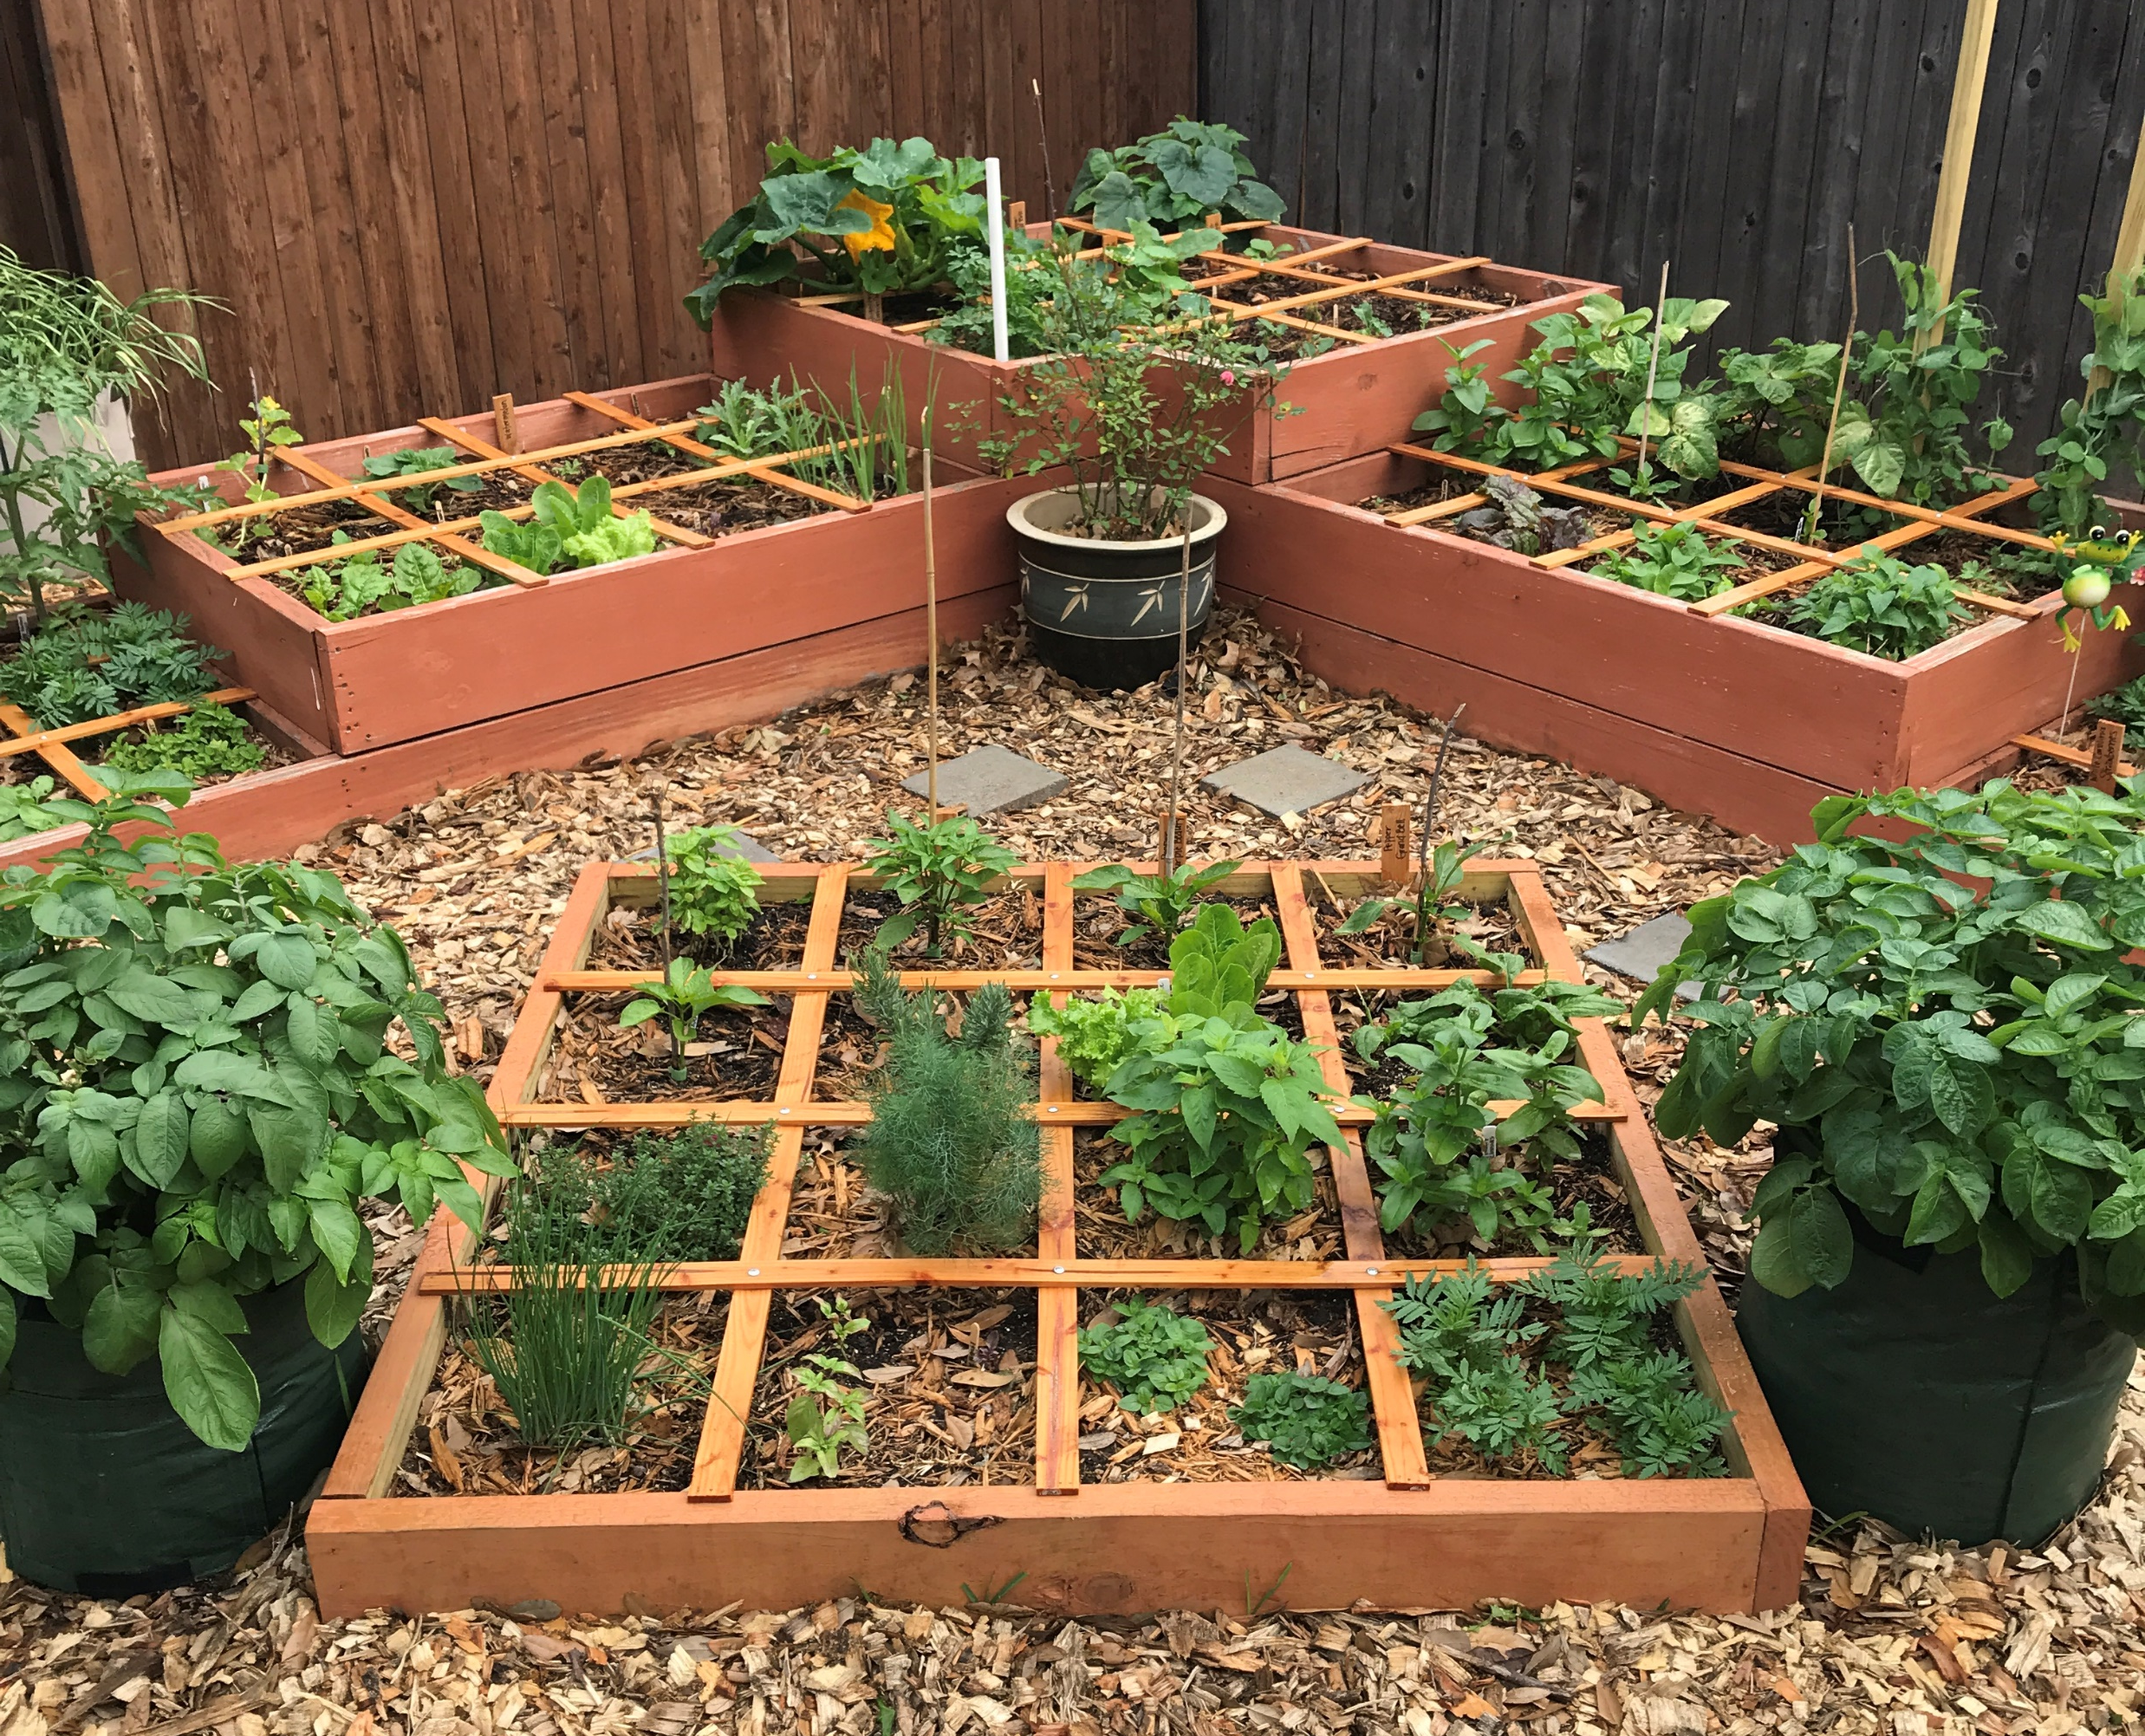
What is the SFG Method?
Space saving
No waste
Mel’s Mix- special growing soil
Grid for plant spacing
Weed barriers- easy maintenance
Easy for beginners

Slide 5
The 10 Basics
Layout – Arrange in squares, not rows.
Boxes – Build boxes to hold new soil (Mel’s Mix) only 6 inches deep
Aisles – Space boxes 3 feet apart to form walking aisles.
Soil – Fill boxes with Mel’s Mix: 1/3 compost, 1/3 peat moss, 1/3 Coarse vermiculite, no worries about what contaminants old soil may have.
Grid – Make a square foot grid for the top of each box to organize garden for planting.
Care – Never walk on growing soil. Tend garden from aisles, pulling few weeds if any with fingers.
Select – Plant different herbs or vegetables using spacing of 1, 4, 9 or 16 plants per square foot.
Plant – Plant only a pinch (2 or 3 seeds) per hole. No waste.
Water – Best to hand water from a bucket of sun warmed water. Hose or drip system OK.
Harvest- After harvesting a square foot, add compost to replenish nutrients and replant with new and different crop.

Slide 6
Advantages of the SFG Method
Saves space
Saves water usage
Strengthens communities
Encourages children & families to garden for nutritious food
Emphasizes the 3 Rs - Reduce, Reuse & Recycle
Positively impacts climate change and sustainability
Promotes healthy plant-based/animal-friendly lifestyle
Perfect for community groups, restaurants, civic organizations, hospitals, veteran's groups, volunteer groups

Slide 7
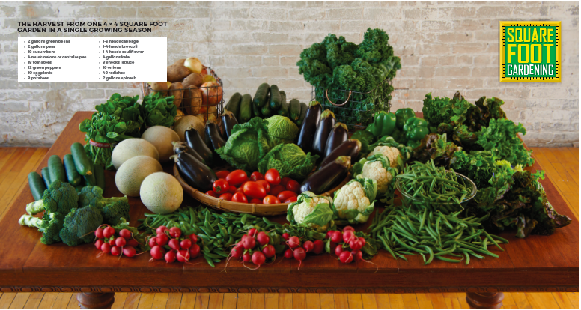
Advantages of the SFG Method continued

Slide 8
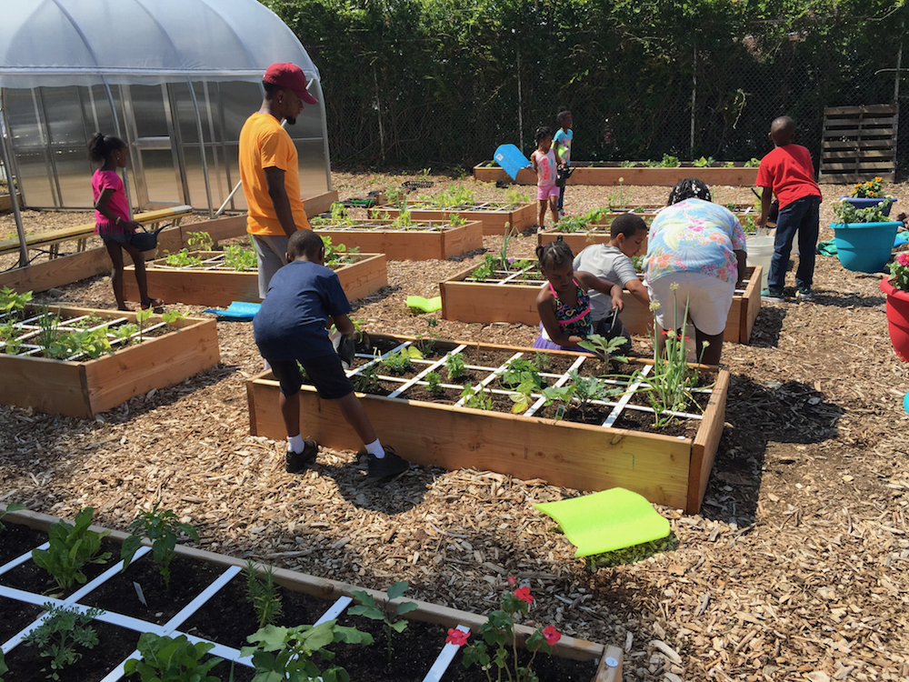
Advantages of the SFG Method continued
Community involvement
Family Gardening

Slide 9
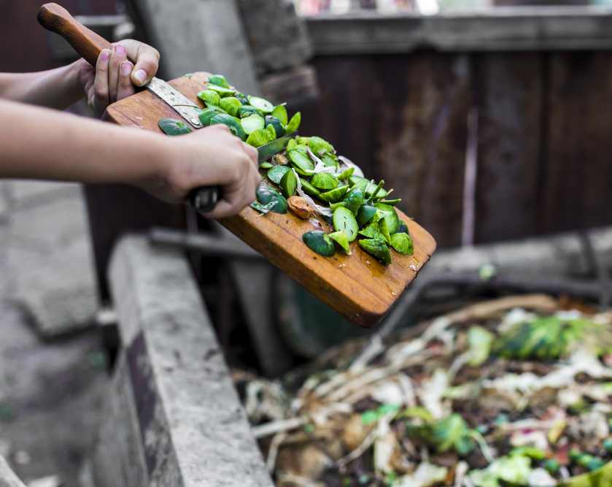
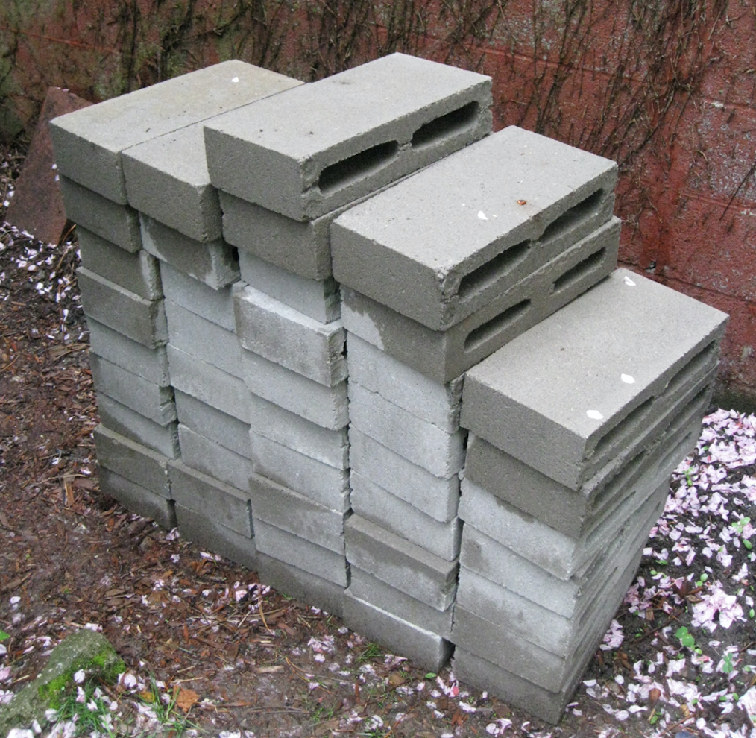
Advantages of the SFG Method continued
Recycle food scraps, compost
Reduce water, waste, seeds
Reuse old building materials, re-plant squares

Slide 10
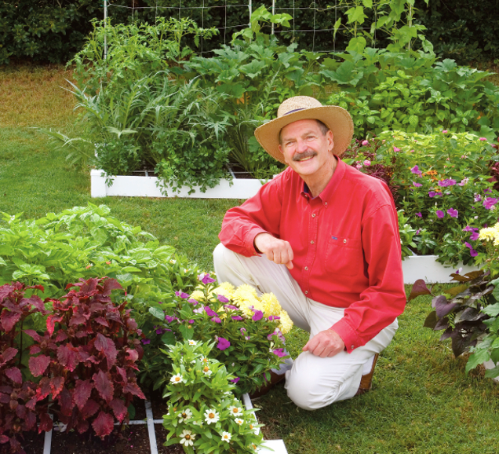
8 Steps of Building Your SFG
1. Planning your garden
2. Laying out a SFG
3. Building boxes and grids
4. Building box accessories
5. Creating Mel's Mix
6. Planting
7. Maintaining
8. Harvesting

Slide 11
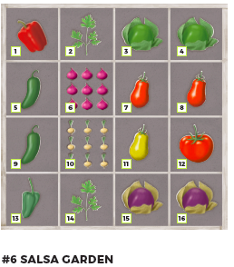
1. Planning Your Garden
Plan your boxes to provide the amount of produce you’ll likely need
Tip: put taller plants on the north side of the box
Chapter 3

Slide 12
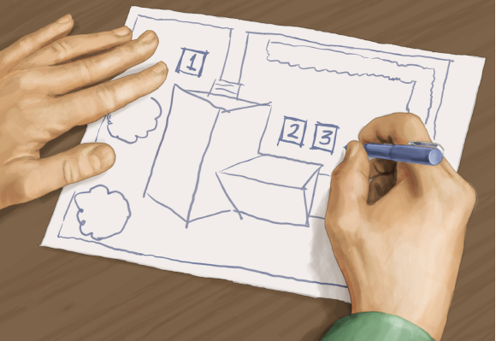
2. Laying out a SFG
Chapter 4 will teach you how to plan the shape and configuration of your SFG boxes and map out where they will be located in your yard or patio
A simple 4’ x 4’ is recommended, but space or sunlight may determine an alternate shape

Slide 13
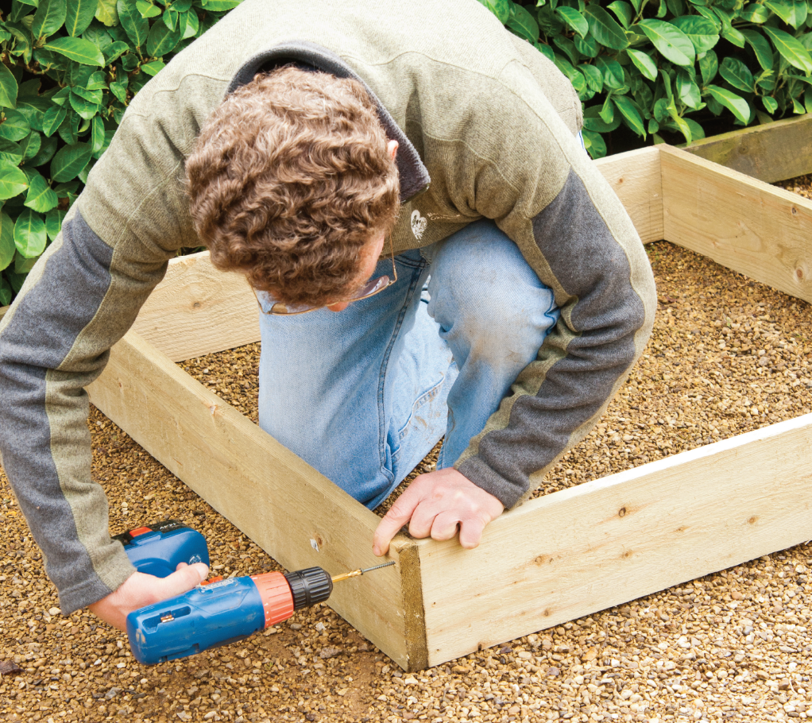
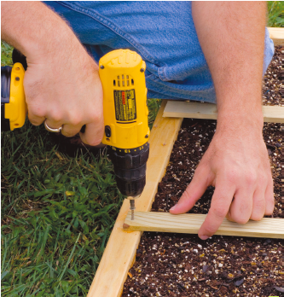
3. Building boxes and grids
Chapter 5 provides instructions for not only the basic 4’ x 4’ box that is 6 inches deep but also a variety of other box shapes and sizes.
Re-use old building materials to create your box!

Slide 14
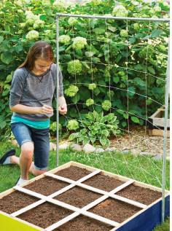
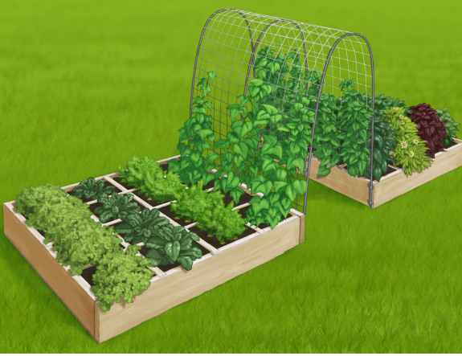
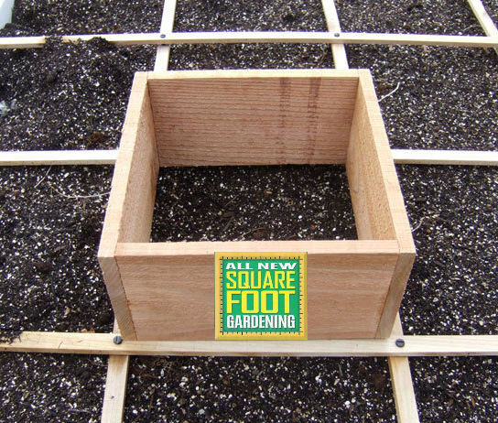
4. Building Box Accessories
Get the maximum productivity and convenience out of your SFG by adding trellises, protective covers, or other accessories
Or, using a standard box with a grid is just fine as well
A top hat for root veggies

Slide 15
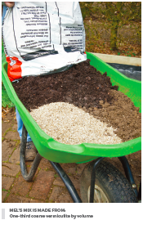
5. Creating Mel’s Mix
One of the most important steps is creating a special growing medium
Mel’s mix will last for 10 years with adding compost
The mix is friable and soft, weed(s) easily removed by hand
Increased water retention
1/3 compost, 1/3 peat moss, 1/3 coarse vermiculite
Chapter 7

Slide 16
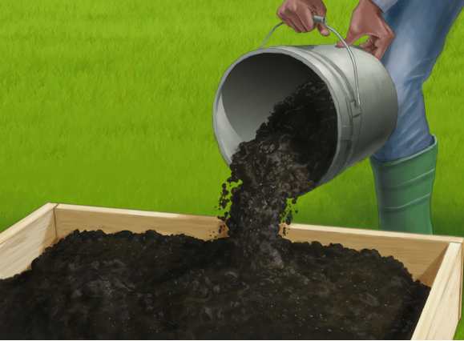
5. Creating Mel’s Mix continued
Materials:
Large tarp
Particle mask for dust
Shovel and rake
5-gallon bucket
Compost (if using store bought, use at least 5 different kinds if possible)
Coarse vermiculite
Peat moss
Wheelbarrow
Water supply

Slide 17
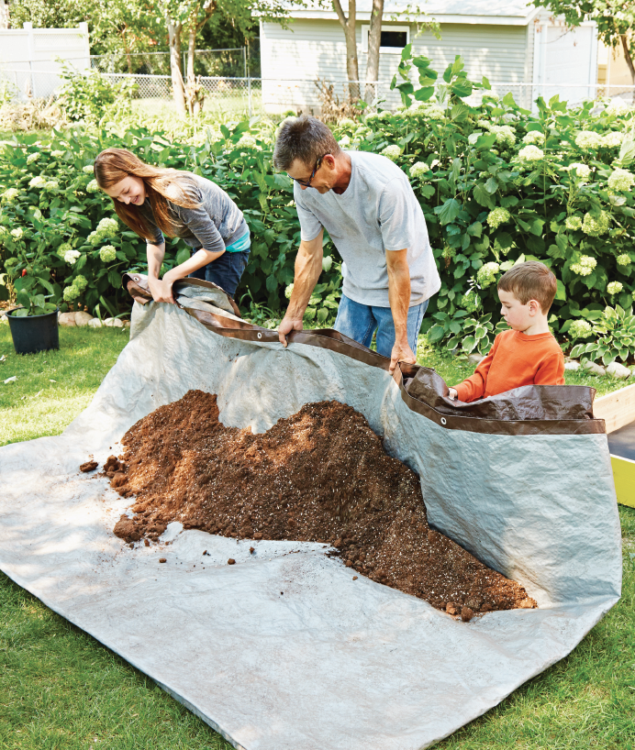
5. Creating Mel’s Mix continued
Making Mel’s Mix:
Spread out a tarp and empty compost onto it
Drag to mix
Add peat moss, mist lightly with hose
Add coarse vermiculite – mix well
Transfer to garden box
Add your grid

Slide 18
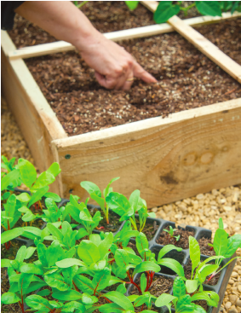
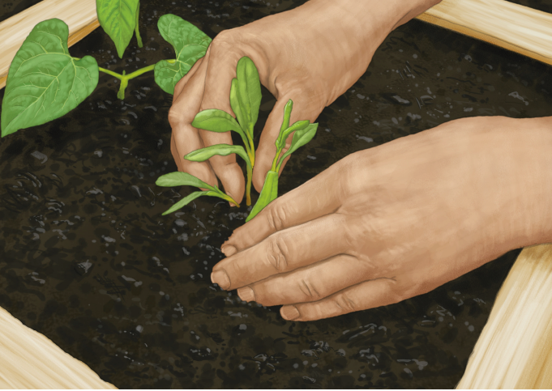
6. Planting
Chapter 8 will provide you all the details about planting practices used in SFG’ing
No seeds are wasted
Transplanted seedlings almost never fail to thrive in Mel’s Mix

Slide 19
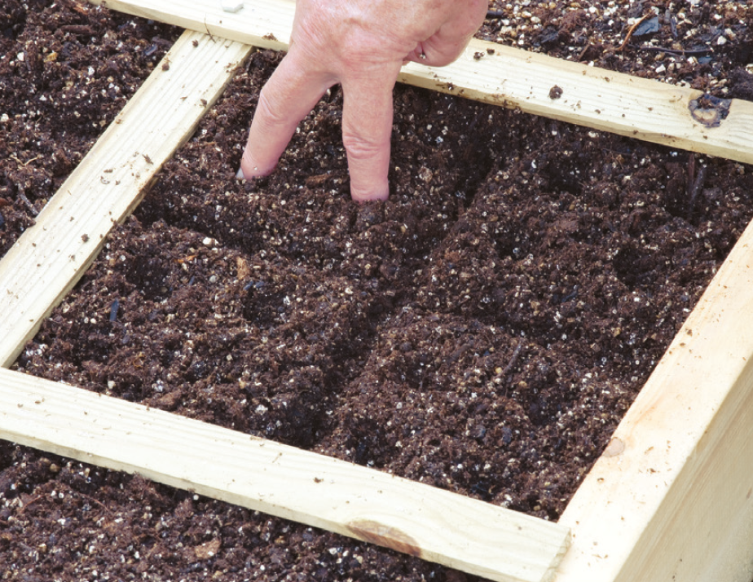
6. Planting continued
Divide your squares
Think of plants in sizes of small, medium, large, and extra large
SFG’ing uses the 1, 4, 9, 16 spacing rule

Slide 20
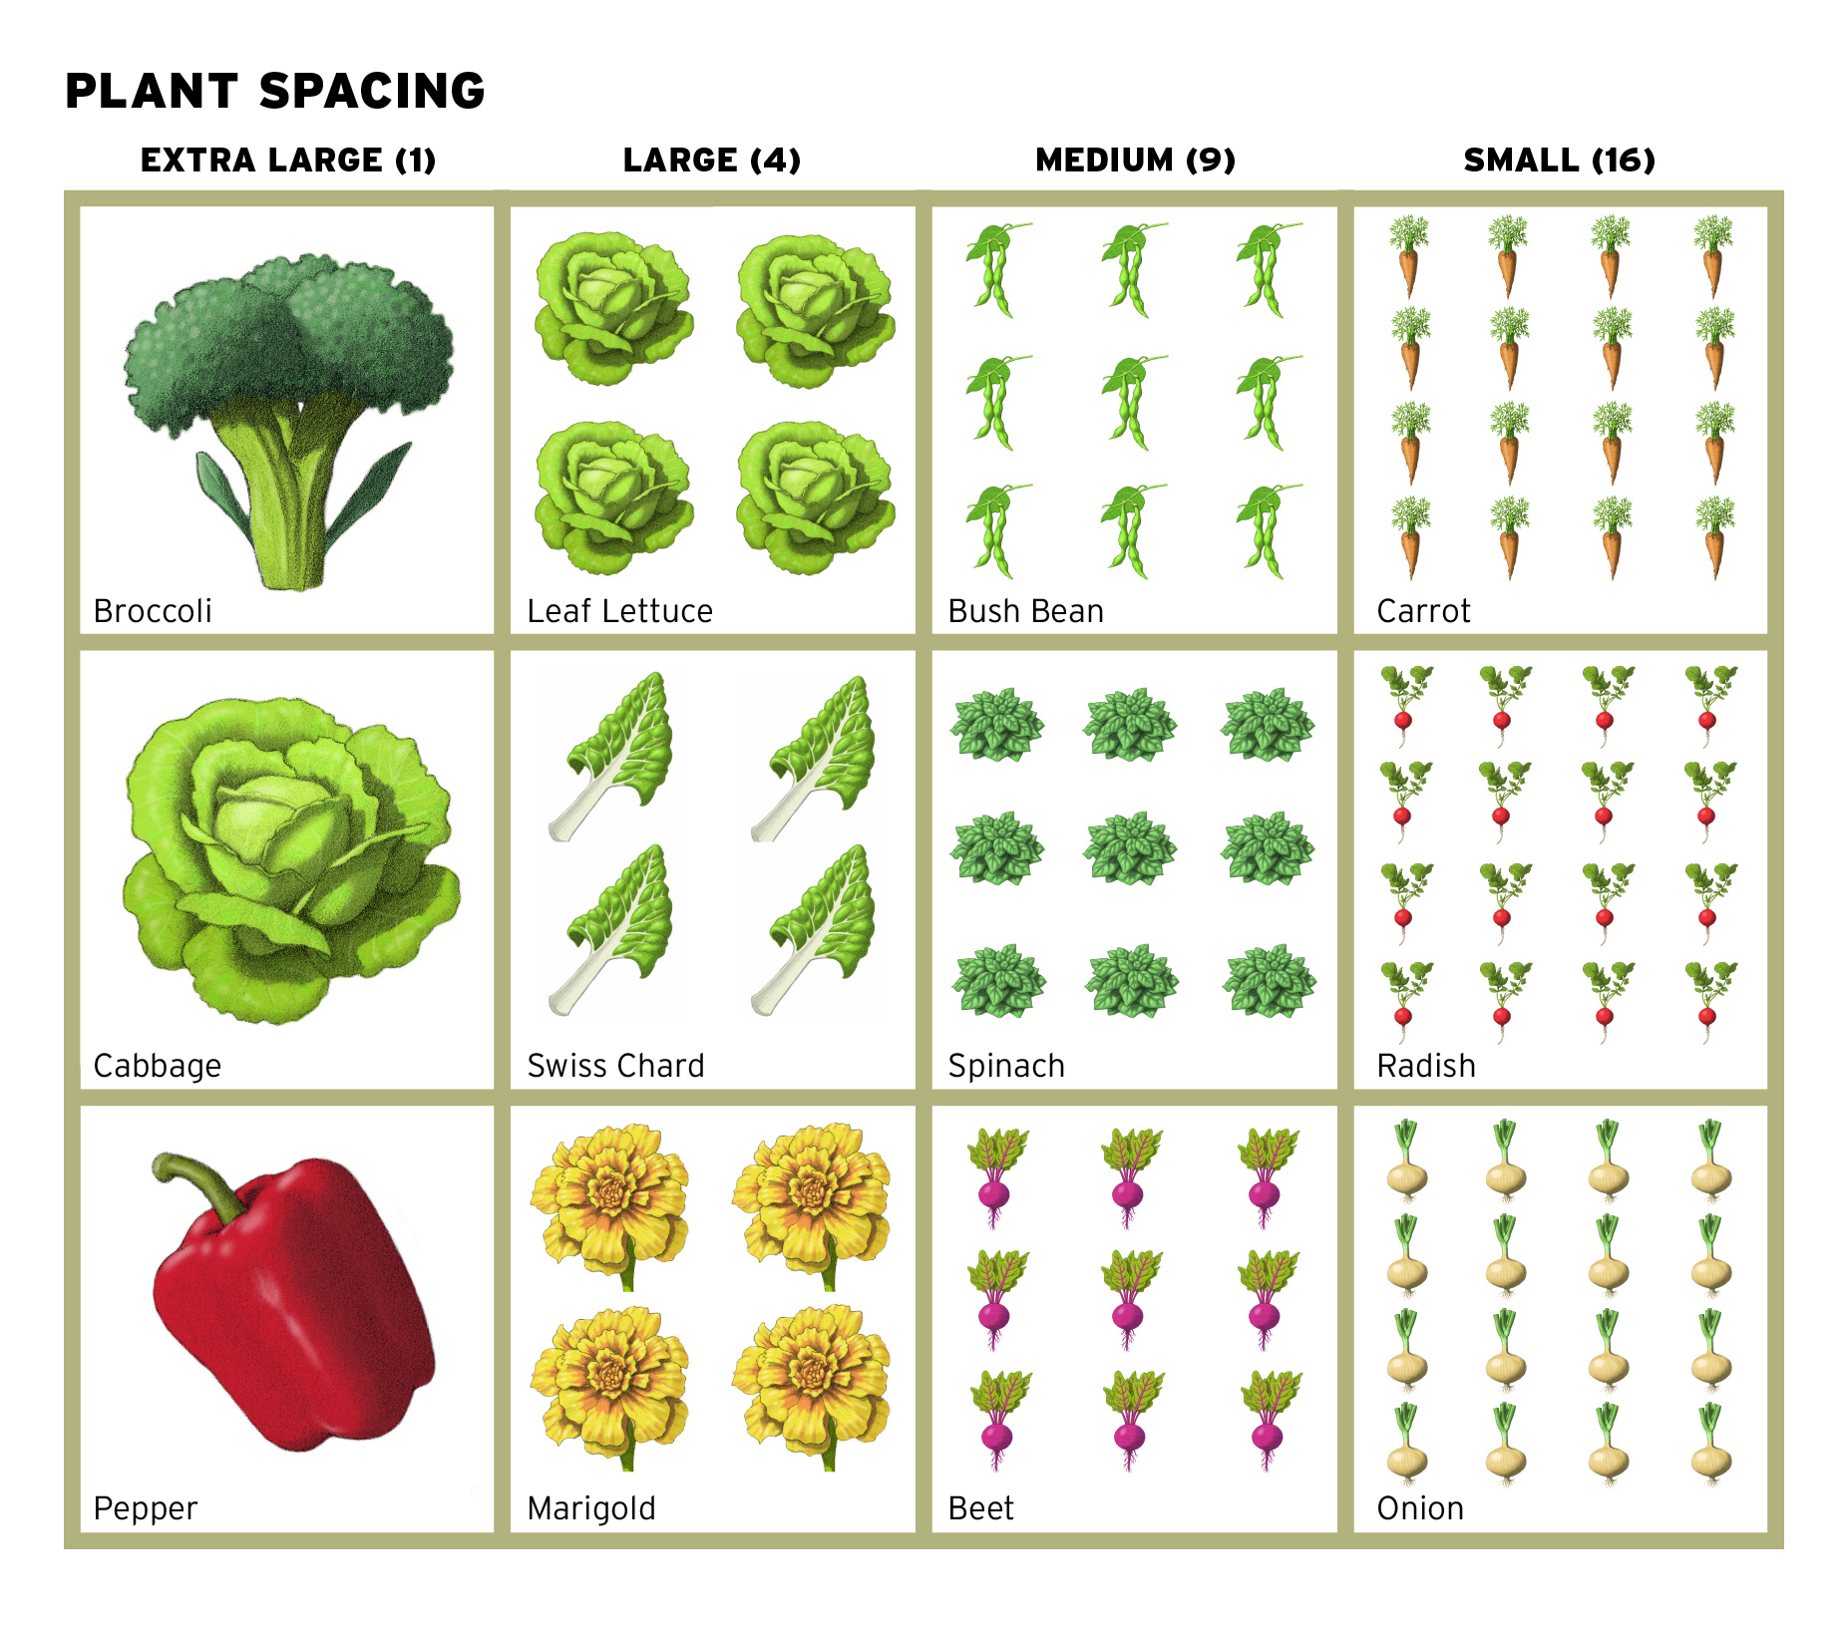
6. Planting continued
1 per square for extra-large crops such as broccoli, cabbage and peppers.
4 per square for large crops such as leaf lettuce, Swiss chard, or even flowers like marigolds.
9 per square for medium crops such as bush beans, spinach, or beets.
16 per square for small crops such as carrots, radishes, or onions.

Slide 21
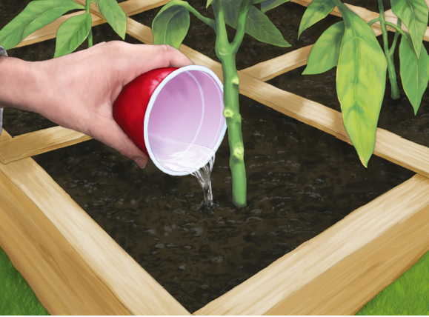
7. Maintaining Your Garden
Chapter 9 includes techniques for watering and weeding your SFG, as well as inspecting it and tending to any pest problems and diseases
The only tools you need: a trowel, pencil, pair of scissors, and a small pruner

Slide 22
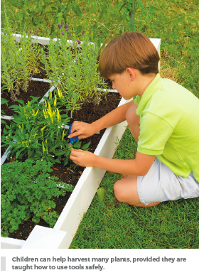
8. Harvesting Your Garden
Chapter 10 will guide you through the harvesting process as your crops ripen
The diverse planting pattern used in the SFG Method allows harvesting to occur all through the garden season

Slide 23
Connect with SFGF
www.squarefootgardening.org
Email: info@squarefootgardening.org
@squarefootgardening

Slide 24
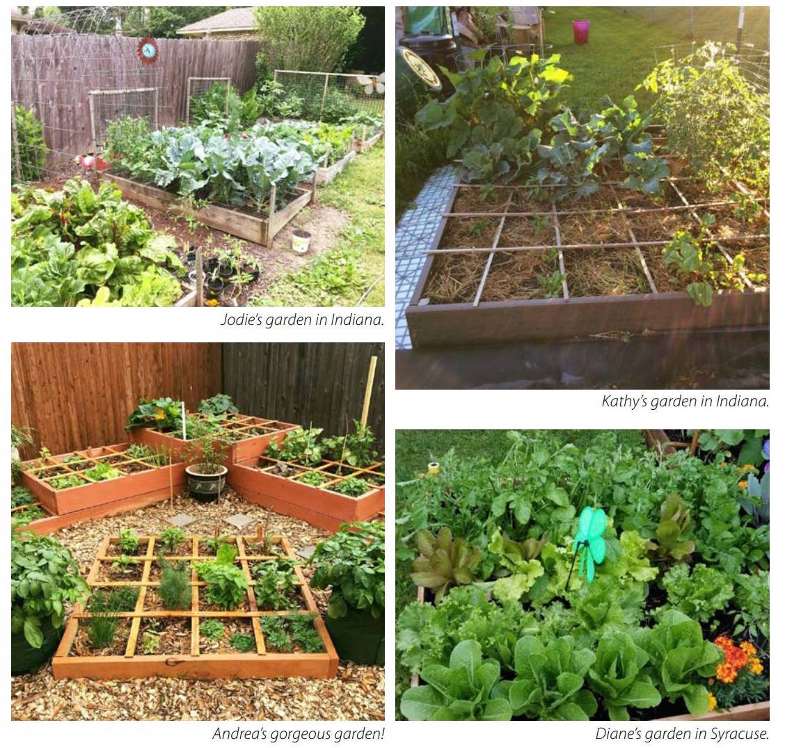

Slide 25
Thank you and happy gardening!

