Slide 1
Interesting and Relevant Facts
Modeled from Info Sheet: Interesting and Relevant Facts

Slide 2
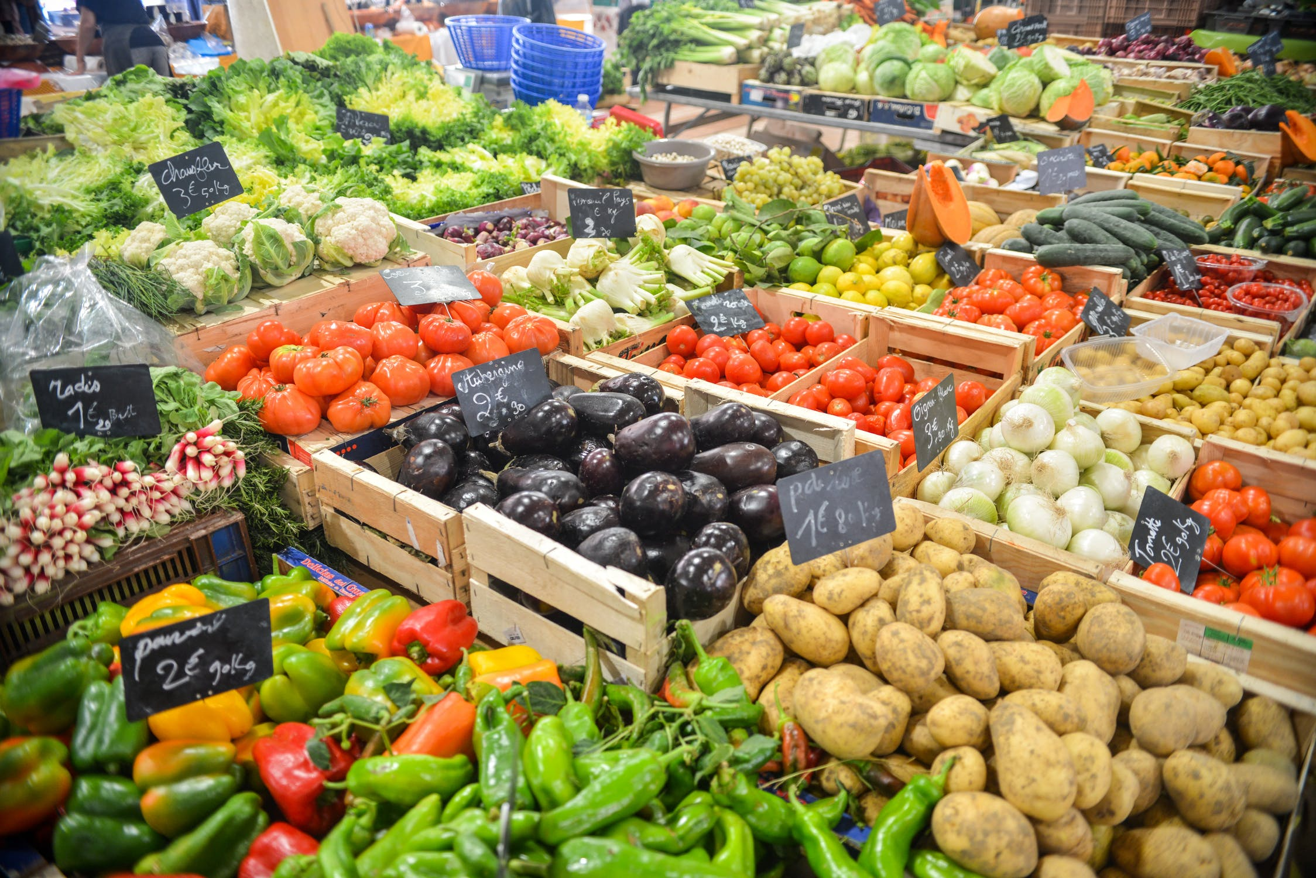
What is a Whole Food, Plant Based Diet?
A WFPB diet consists of whole foods that are minimally processed, such as: vegetables, fruits, nuts, whole grains, legumes/beans, and ingredients and meals that have no added oil and are low in salt and sugar.

Slide 3
Arm Yourself with Information
This PowerPoint contains several interesting facts and statistics to support the scientific underpinnings of a WFPB diet.
Use this as a resource when talking to your friends and family about the benefits of, and reasons for, a plant-based diet.
The facts and statistics about:
Millennials and Veganism
Milk Sales
Protein and Calcium Sources
Milk and Bone Health
American Healthcare
Vegan Athletes and Celebrities
WFPB is Cheaper, Healthier, and Tastier

Slide 4
Millennials and Veganism:
Younger generations are becoming increasingly aware of the health, environmental, and ethical consequences of their food choices.
A 2011 study¹ revealed 12% of millennials are “faithful vegetarians” compared to 4% of Generation X, and only 1% of Baby Boomers.
A 2017 report² on the “Top Trends in Prepare Foods” found that:
6% of US consumers now claim to be vegan, up from just 1% in 2014
Two (out of six) key trends impacting food innovation are:
“Go Meat-Free” – a demand for meat-free products and substitutes
“Ethical Eating” – due to an increase in ethical and sustainable lifestyles
¹http://store.hartman-group.com/culture-of-millennials-2011/?hcampaign
²https://www.reportbuyer.com/product/4959853/top-trends-in-prepared-foods-2017-exploring-trends-in-meat-fish-and-seafood-pasta-noodles-and-rice-prepared-meals-savory-deli-food-soup-and-meat-substitutes.html

Slide 5
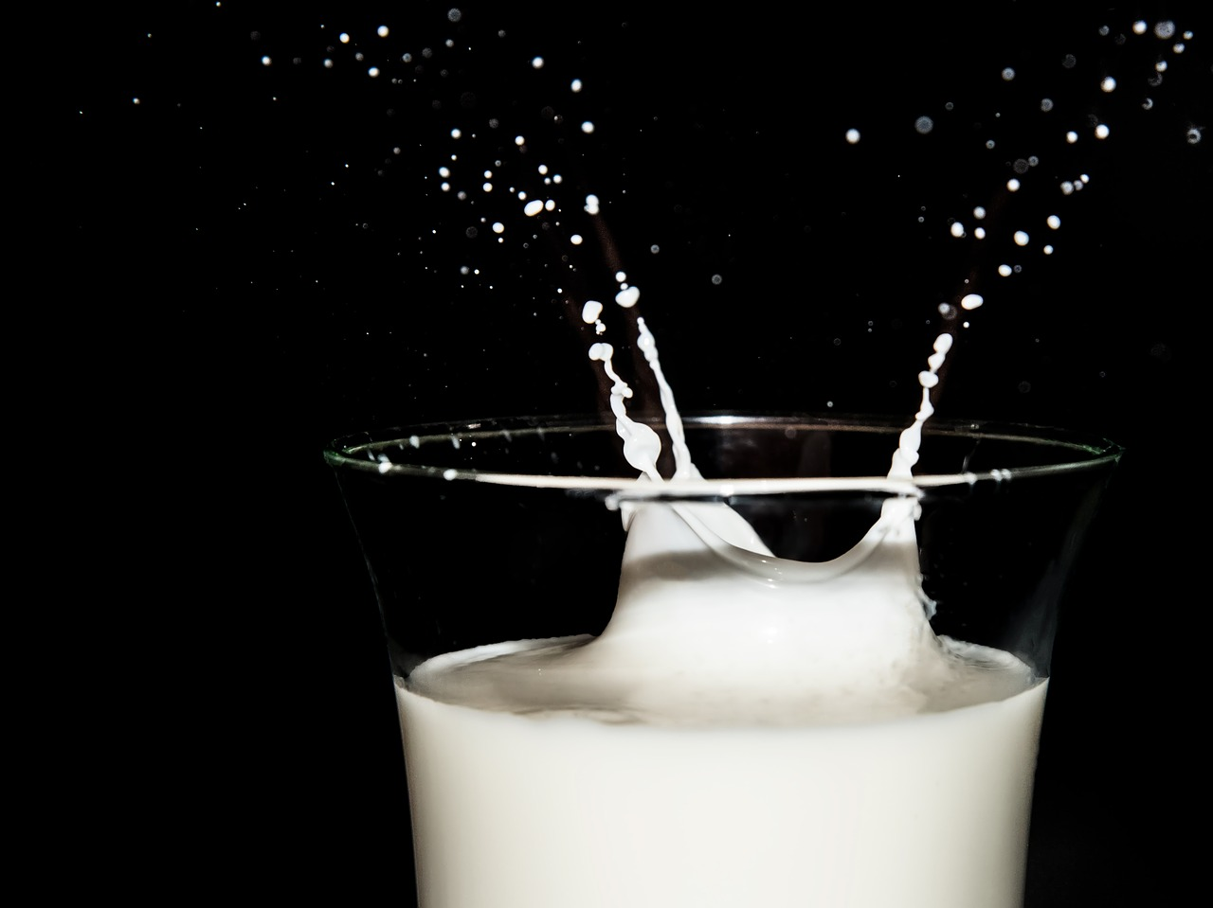
Milk Sales
Public demand for plant-based milks is increasing as the demand for cow’s milk declines.
From 2016-2017, plant-based milk sales went up 3.1% and cow’s milk sales went down 5%¹.
Non-dairy alternative milk sales have grown 250% in the past 5 years².
Elmhurst Dairy, one of the largest dairy operators on the East Coast, stopped producing cow’s milk in 2016 and instead now only sells plant-based milks³.
¹http://www.prweb.com/releases/2017/09/prweb14683840.htm
²https://www.forbes.com/sites/michaelpellmanrowland/2017/04/11/milk-industry-controversy/2/#4b2fed7b437f
³https://www.forbes.com/sites/michaelpellmanrowland/2017/04/11/milk-industry-controversy/2/#4b2fed7b437f

Slide 6
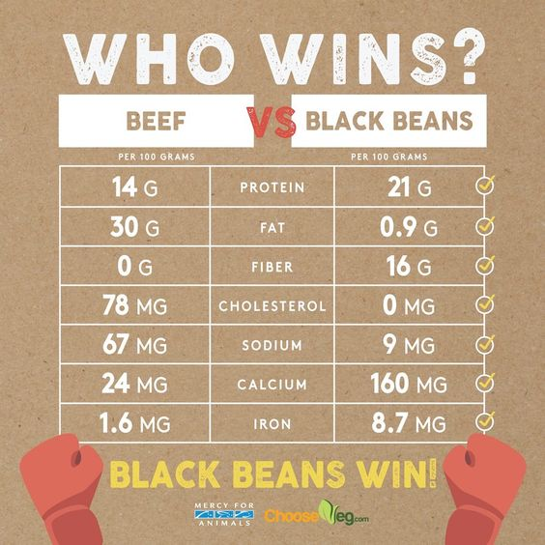
Protein Sources
Many people believe meat is the best source of dietary protein, when lots of common plant foods are jam-packed with protein! This info-graphic from Mercy for Animals lays out the facts on protein and much more:
http://tinyurl,com/beansvsbeefimage

Slide 7
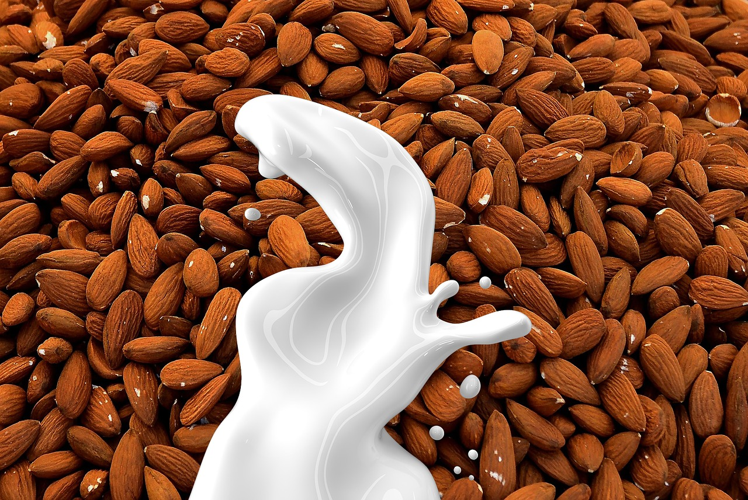
Calcium Sources
Due to effective marketing from the dairy industry, it is still widely believed that cow’s milk is the best source of calcium. As you will see over the next two slides, research shows this is not the case.
One cup of 2% milk has 295mg of calcium and one cup of whole milk has 276mg¹.
Plant-based foods are far greater sources of calcium without negative health effects:
1 cup almond milk = 450mg²
1 cup tofu = 516mg³
1 cup cooked collard greens = 358mg³
10 medium figs = 270mg³
1 cup cooked spinach = 244mg³
¹https://ndb.nal.usda.gov/ndb/
²https://www.fooducate.com/app#!page=product&id=5388BE3E-19C6-6FF4-4A1B-86836A2A5615
³http://www.vegkitchen.com/nutrition/calcium/

Slide 8
Milk and Bone Health
Unlike plant-based sources of calcium, research shows that cow’s milk actually leaches calcium from our bones:
According to Dr. Michael Greger, M.D., there is “no association between milk consumption and lower hip fracture risk¹”.
Harvard researchers determined that milk consumption during teenage years is not associated with a lower risk of hip fracture, and instead, milk consumption is associated with an increased risk for fracture in men¹.
A ‘calcium paradox’ exists, wherein countries that consume greater amounts of cow’s milk and calcium, also have higher rates of osteoporosis and fractures².
¹https://nutritionfacts.org/2017/01/31/why-is-milk-consumption-associated-with-more-bone-fractures/
²http://nutritionstudies.org/4-keys-to-strong-bones/

Slide 9
American Healthcare
America spends the most money per capita on healthcare than any other nation in the world, yet we are not healthier because of it:
In 2015 America’s healthcare spending was $3.2 trillion, or an average of $9,990 per person. This amounted to 17.8% of America’s GDP¹.
The American Healthcare system is ranked #37 worldwide by The World Health Organization².
As reported by an Oxford study³, a plant-based diets could save the world $1 trillion in healthcare costs annually by 2050.
¹httphttps://www.cms.gov/Research-Statistics-Data-and-Systems/Statistics-Trends-and-Reports/NationalHealthExpendData/downloads/highlights.pdf
²http://www.who.int/healthinfo/paper30.pdf
³http://www.pnas.org/content/113/15/4146.full

Slide 10
Vegan Athletes and Celebrities
A plant-based diet even supports some of the strongest and most active athletes, and popular celebrities including:
Vegan Athletes¹: Mike Tyson (former boxer), Ricky Williams (NFL), John Salley (NBA), Georges Laraque (NHL), Pat Neshek (MBL), Robert Cheeke (bodybuilder), and Venus Williams (tennis player), to name a few.
Vegan Celebrities²: Alicia Silverstone, Woody Harrelson, Joaquin Phoenix, Ellen Page, Ariana Grande, Ellen DeGeneres, Miley Cyrus, Liam Hemsworth, Joan Jeet, Sia, Stevie Wonder, RZA, Wacka Flocka Flame, and many more.
¹htthttp://www.therichest.com/sports/other-sports/top-10-vegetarian-or-vegan-athletes/
²https://www.bustle.com/articles/149515-32-verified-currently-vegan-celebrities

Slide 11
Eating WFPB is Cheaper, Healthier, and Tastier:
A 2016 study¹ found that eating a plant-based diet saved each person about $750 annually, while providing more servings of fruits, vegetables and whole grains than the most economical recommendations for health eating from the United States Department of Agriculture (USDA).
Plant-based diets can be as inexpensive as $5 a day, while still providing adequate nutrition².
This article³, Plant-Based Food Guide: How to Eat Well on a Budget, discusses healthy meal suggestions, budgeting at the grocery story, and tips for stretching your grocery dollars.
Brand New Vegan’s blog post⁴ explains 5 ways to save money when going plant-based.
¹https://www.eurekalert.org/pub_releases/2016-01/l-mhr010416.php
²https://www.mindbodygreen.com/0-23361/how-to-eat-vegan-on-just-5-a-day.html
³http://nutritionstudies.org/plant-based-on-a-budget/
⁴http://www.brandnewvegan.com/tips-and-tricks/5-ways-to-save-money-by-going-vegan

Slide 12
Thank you!
Please refer to the Info Sheet: Interesting and Relevant Facts for a closer look at the sources presented in this PowerPoint.
For more information on similar topics take a look at:
Info Sheet: Where Do You Get Your Protein, located in the Transitioning to WFPB Toolkit
PPC’s FAQ section, also located in the Transitioning to WFPB Toolkit.
Disclaimer: The information shared by PlantPure Communities (PPC) is not intended to be a substitute for professional medical advice, diagnosis, or treatment. Always seek the advice of your physician or other qualified health provider with any questions you may have regarding a medical condition. If you are on medication and are changing to a whole food, plant-based diet, you should discuss with your healthcare provider the changes that you are making in your diet and how these changes may require an adjustment in medication dosage. It is important that you work with your doctor to monitor your condition and medication dosage during your change of dietary practices.

